Slide 1
Explain HDFS Architecture
SlideMake.com

Slide 2
Introduction to HDFS Architecture
HDFS stands for Hadoop Distributed File System, a key component of the Hadoop ecosystem.
It is designed to store large files across multiple machines in a distributed environment.
HDFS provides high-throughput access to application data and is optimized for large-scale data processing.
Notes:
Image source: https://www.researchgate.net

Slide 3
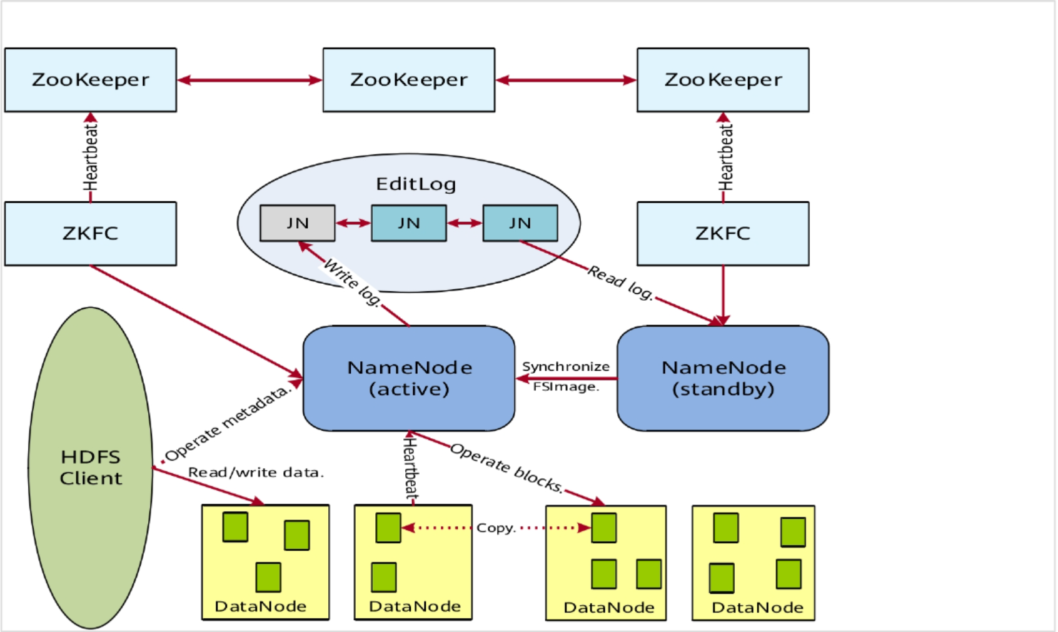
Key Features of HDFS
HDFS is highly fault-tolerant, allowing it to recover from hardware failures easily.
It supports large files, typically in the gigabyte to terabyte range, making it suitable for big data applications.
The system is designed for high throughput rather than low latency, which is ideal for batch processing.
Notes:
Image source: https://forum.huawei.com

Slide 4
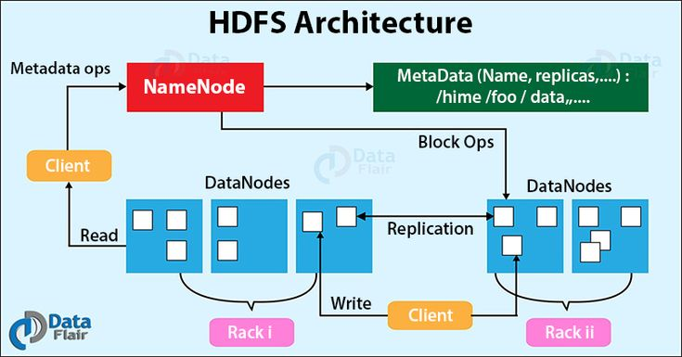
HDFS Architecture Overview
HDFS follows a master/slave architecture with two main components: NameNode and DataNode.
The NameNode manages the metadata and namespace of the file system, while DataNodes are responsible for storing actual data.
This separation allows for efficient data management and retrieval, ensuring scalability and performance.
Notes:
Image source: https://i.pinimg.com

Slide 5
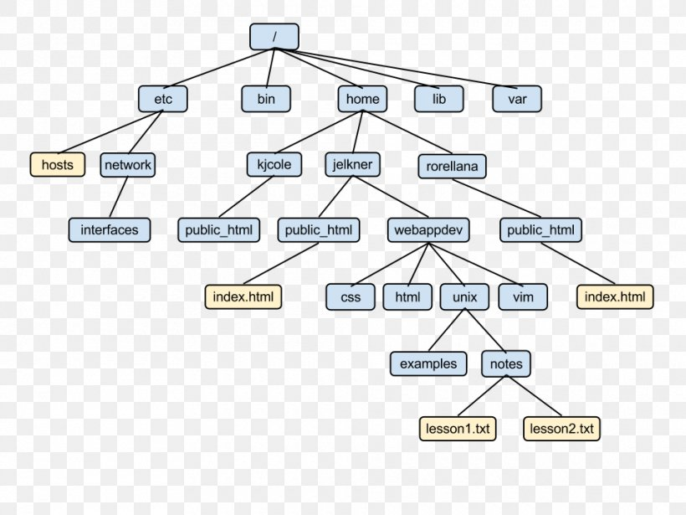
The NameNode
The NameNode is the master server that maintains the file system tree and metadata.
It keeps track of where file data is stored across multiple DataNodes, which helps in managing storage efficiently.
NameNode is critical for the operation of HDFS, but it is a single point of failure, hence often backed up by a Secondary NameNode.
Notes:
Image source: https://img.favpng.com

Slide 6
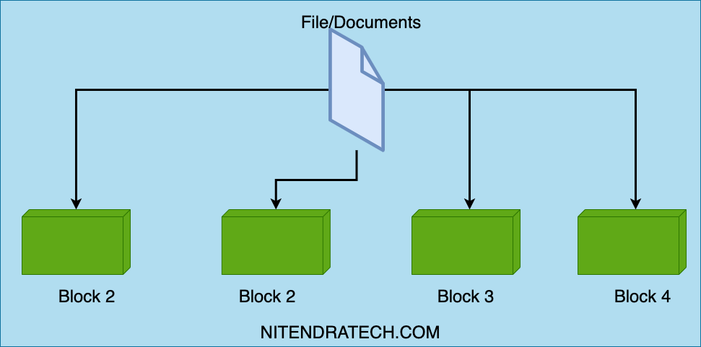
The DataNodes
DataNodes are the slave nodes that store the actual data blocks in HDFS.
They periodically report their status to the NameNode, including block locations and health information.
DataNodes also handle read and write requests from clients, ensuring high availability of data.
Notes:
Image source: https://www.nitendratech.com

Slide 7
Data Storage and Replication
HDFS splits files into large blocks, typically 128 MB or 256 MB, which are distributed across DataNodes.
Each block is replicated across multiple DataNodes to ensure reliability and data availability.
The default replication factor is three, meaning each block is stored on three different nodes.
Notes:
Image source: https://www.researchgate.net

Slide 8
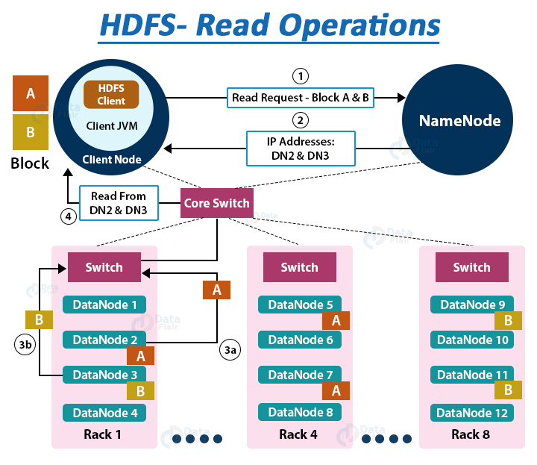
Data Access in HDFS
Clients interact with HDFS primarily through the NameNode to obtain metadata information.
After obtaining the block location from the NameNode, clients directly communicate with DataNodes for data access.
This architecture minimizes the load on the NameNode and enhances data retrieval speed.
Notes:
Image source: https://data-flair.training

Slide 9
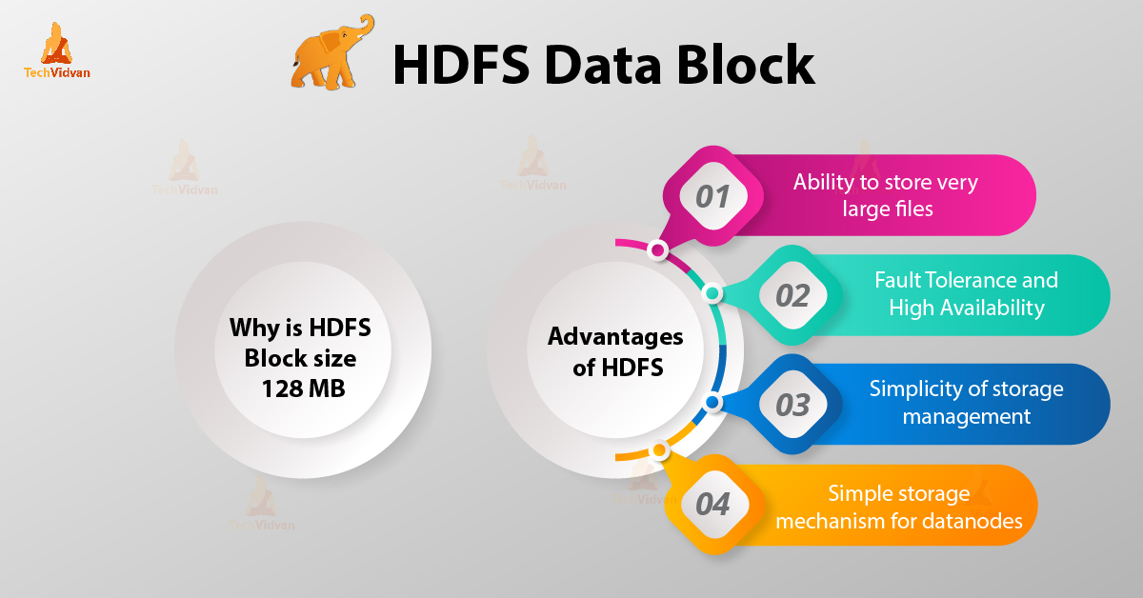
Conclusion and Use Cases
HDFS is an integral part of big data applications, supporting vast amounts of data storage and processing.
It is commonly used in data-intensive sectors like finance, healthcare, and social media analytics.
Understanding HDFS architecture is crucial for leveraging the full potential of Hadoop for distributed data processing.
Feel free to customize any part of this presentation to better suit your audience or specific requirements!
Notes:
Image source: https://techvidvan.com

